Slide 1
Applied Parallel Computing with Python – List of Tasks
PyCon 2013

Slide 2
Goal
Tackle CPU-bound tasks
Accept the GIL
Utilise many cores on many machines
Maybe utilise many languages too

Slide 3
Overview (pre-requisites)
multiprocessing
ParallelPython
hotqueue, redis (and Redis system)
Matplotlib (for visualisations)

Slide 4
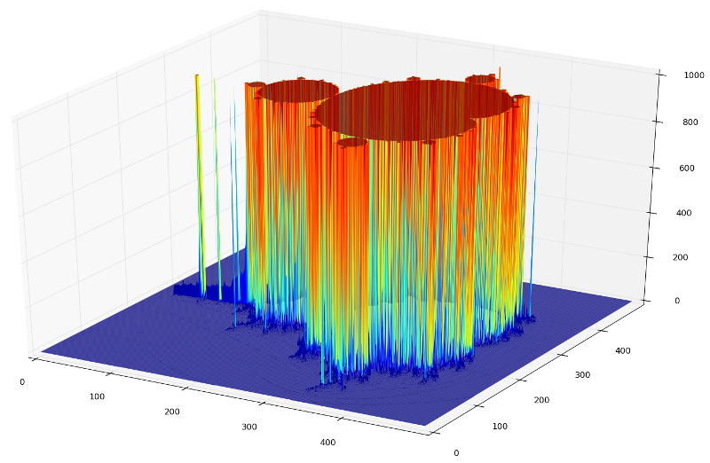
Mandelbrot as surface plot

Slide 5
Serial single thread
$ python serial_python.py --plot3D --size 100
2500 elements
$ python serial_python.py
250,000 elements
11 seconds on 1 core

Slide 6
Amdahl's law
Max speed-up is limited to the parallelisable portions and resources
What serial constraints do we have?
How many data elements?
How much memory?
What affects transmission speed? Gigabit? Switches? Traffic?

Slide 7
Memory usage?
import sys
sys.getsizeof(0+0j) # 32 bytes
250,000 * 32 == ? # lower-bound
Pickling and sending will take time
Assembling the result will take time

Slide 8
Profile memory usage
Github fabianp memory_profiler
$ python -m memory_profiler serial_python_temp.py #argparse
Output (takes a while):
61:q.append(complex...) # +25MB
65:...=calculate_z(...) # +7MB

Slide 9
multiprocessing
Using all our CPUs is cool, 4 are common, 32 will be common
Global Interpreter Lock (isn't our enemy)
Silo'd processes are easiest to parallelise
Forks on local machine (1 machine only)
http://docs.python.org/library/multiprocessing.html

Slide 10
Making chunks of work
Split the work into chunks
Start splitting by number of CPUs
Submit the jobs with map_async
Get the results back, join the lists
Profile and consider the results...

Slide 11
multiprocessing Pool
2_mandelbrot_multiprocessing/
multiproc.py
p = multiprocessing.Pool()
po = p.map_async(fn, args)
result = po.get() # for all po objects
join the result items to make full result

Slide 12
multiprocessing
1 process takes 12 secs
2 takes 6 secs (watch System Monitor)
4 takes about 5 – what's happening?
What about 32?

Slide 13
ParallelPython
Same principle as multiprocessing but allows >1 machine with >1 CPU
http://www.parallelpython.com/
Seems to work poorly with lots of data (e.g. 8MB split into 4 lists...!)
We can run it locally, run it locally via ppserver.py and run it remotely too
Can we demo it to another machine?

Slide 14
Running ParallelPython
Run
$ python parallelpy.py #chunks
Now to run server separately:
$ ppserver.py -d -a # uses all CPUs
$ python parallelpy_manymachines.py

Slide 15
ParallelPython + binaries
We can ask it to use modules, other functions and our own compiled modules
Works for Cython and ShedSkin
Modules have to be in PYTHONPATH (or current directory for ppserver.py)

Slide 16
“timeout: timed out”
Beware the timeout problem, the default timeout isn't helpful:
  pptransport.py
  TRANSPORT_SOCKET_TIMEOUT = 60*60*24 # from 30s
Remember to edit this on all copies of pptransport.py

Slide 17
Redis queue
Queue is persistent, architect. agnostic
Server/client model, time shift ok
1$ python hotq.py # worker(s)
2$ python hotq.py --server
What if many jobs get posted and you're consumers aren't running?
Also->Amazon Simple Queue Service

